Slide 1





RETAIL DEMAND FORECASTING & INVENTORY OPTIMIZATION
WALMART CASE STUDY
BY:THOBEKA JALI DATA SCIENTIST

Slide 2

01
02
03
Executive Summary
Business Challenges
Solution Overview & Core Capabilities
04
05
06
OVERVIEW
Strategic Business Insights
Forecasting Approach
Business Applications
07
08
09
Inventory Optimization Strategy
Final Strategic Recommendations
Q&A

Slide 3
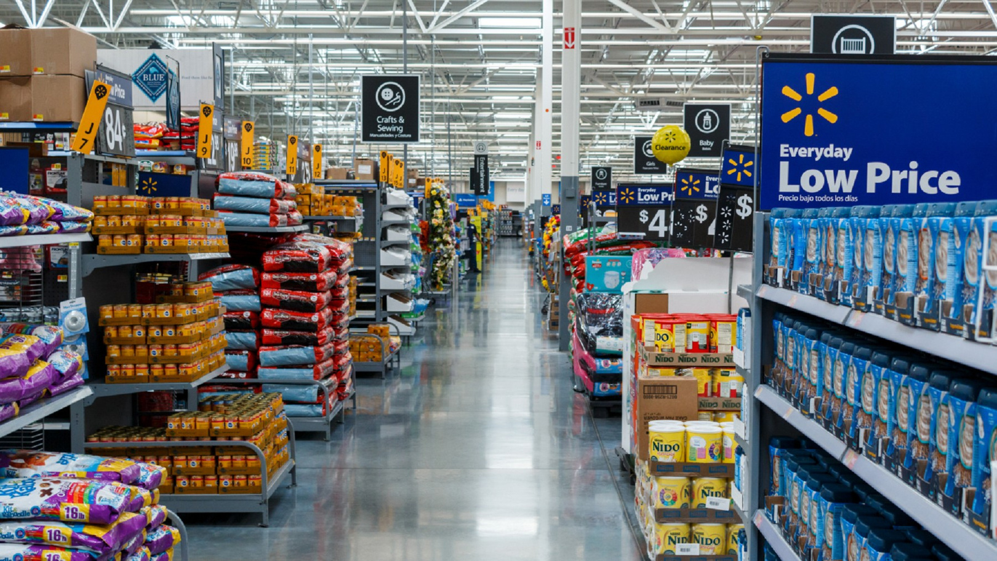


01
EXECUTIVE SUMMARY
Why demand forecasting & inventory optimization matter in retail
Project scope: 45 Walmart stores, AI-powered solution
Business impact focus: profitability, customer satisfaction, agility

Slide 4

BUSINESS CHALLENGES
02
01
Unpredictable customer demand (holiday & seasonal spikes)
02
Inventory imbalances (overstock vs. understock)
03
Sales inconsistency across stores and time
04
Impact: lost sales, excess costs, customer dissatisfaction

Slide 5

03
SOLUTION OVERVIEW
Solution
Hybrid AI models: SARIMAX + LSTM
Inputs: Historical sales, calendar, fuel price, temperature, etc.
Interactive dashboards for decision-making
Advantages
Accurate Forecasting Across Time Horizons
Responsive to External Market Drivers
Real-Time, Actionable Insights via Dashboards

Slide 6




BENEFIT 1
Align inventory with demand patterns (weekly/monthly/quarterly)
CORE CAPABILITIES DELIVERED
BENEFIT 2
Identify underperforming and high-potential stores
BENEFIT 3
Early detection of demand surges
BENEFIT 4
Correlate store performance with market signals

Slide 7
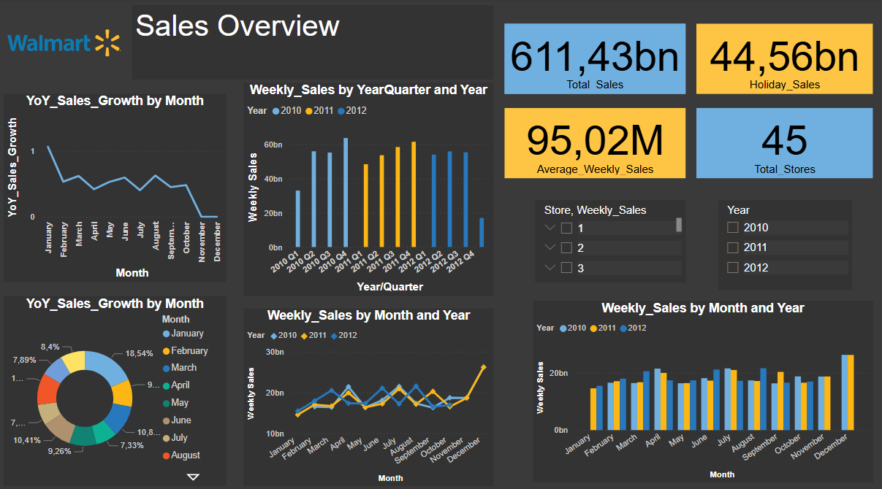
DASHBOARD 1: SALES OVERVIEW

Slide 8
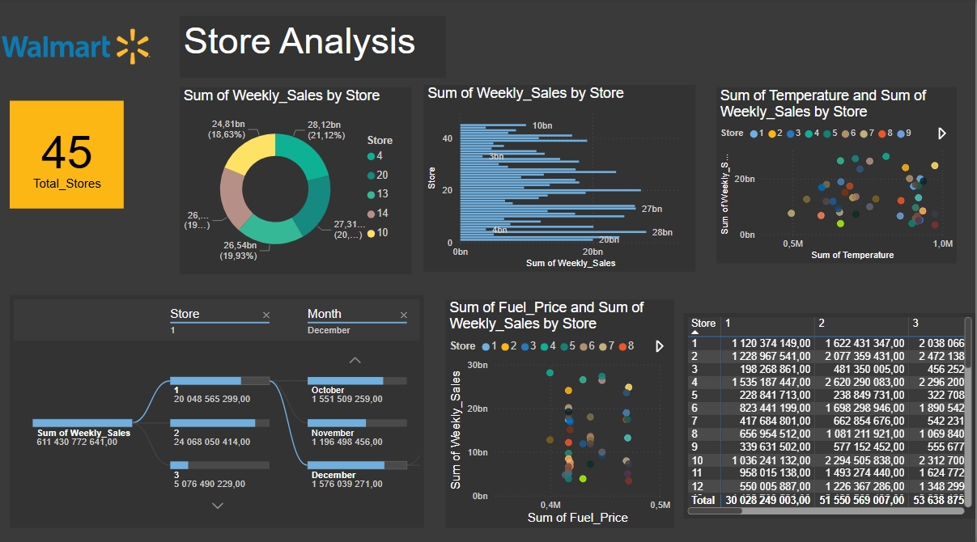
DASHBOARD 2: STORE OVERVIEW

Slide 9




STRATEGIC VALUE
04
Operational Excellence: stock turnover & cost reduction
Revenue Uplift: data-driven campaigns & promotions
Customer Centricity: product availability
Resilience: proactive forecasting
OPERATIONS
REVENUE
CUSTOMERS
RESILIENCE

Slide 10

STRATEGIC BUSINESS INSIGHTS & RECOMMENDATIONS
MONTHLY & QUARTERLY SALES TRENDS
Key months: Jan, Mar, Dec strongest; Nov underperforms
Q4 biggest sales contributor
Recommendations: Early campaigns in Nov, rolling forecasts for Q4, logistics readiness
STORE-LEVEL PERFORMANCE
Top stores: #4, 20, 14 (>ZAR 26B sales)
Low performers < ZAR 10B
Recommendations: Segment inventory, localized marketing, replicate success

Slide 11
STRATEGIC BUSINESS INSIGHTS & RECOMMENDATIONS
EXTERNAL DRIVERS IMPACT
Positive correlation: warmer weather → sales increase
Negative correlation: fuel price increase → sales decrease
Recommendations: Seasonal SKUs, fuel-price-responsive marketing

Slide 12

05
FORECASTING APPROACH & METHODOLOGY
Data sources & integration: 3 years weekly data, external factors
Hybrid models: SARIMAX (short-term) & LSTM (long-term)
Model evaluation: RMSE, MAE, MAPE, backtesting

Slide 13
QUARTERLY FORECAST (12 STEPS):
stable then plateau, uncertainty grows
MONTHLY FORECAST (36 STEPS):
clear seasonality, amplified oscillations
FORECAST RESULTS
WEEKLY FORECAST (156 STEPS)
high variability, promotion-driven spikes
INSIGHTS:
Use forecasts for inventory, staffing, marketing, risk planning

Slide 14
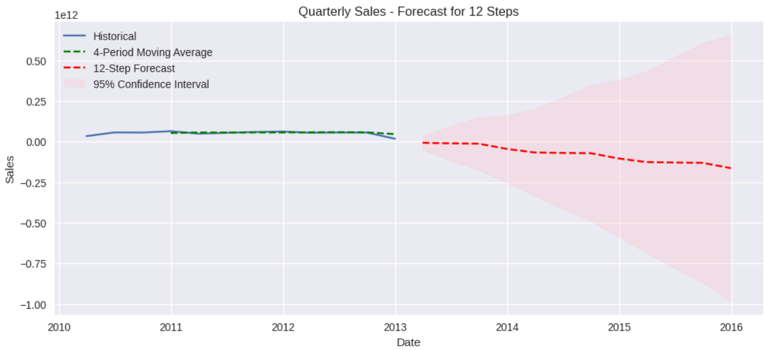
QUARTER SALES FORECAST

Slide 15
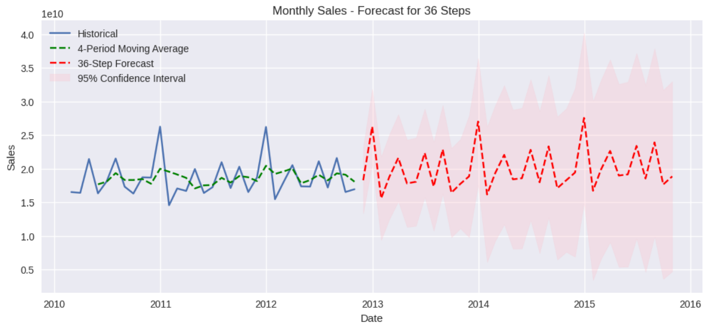
MONTHLY SALES FORECAST

Slide 16
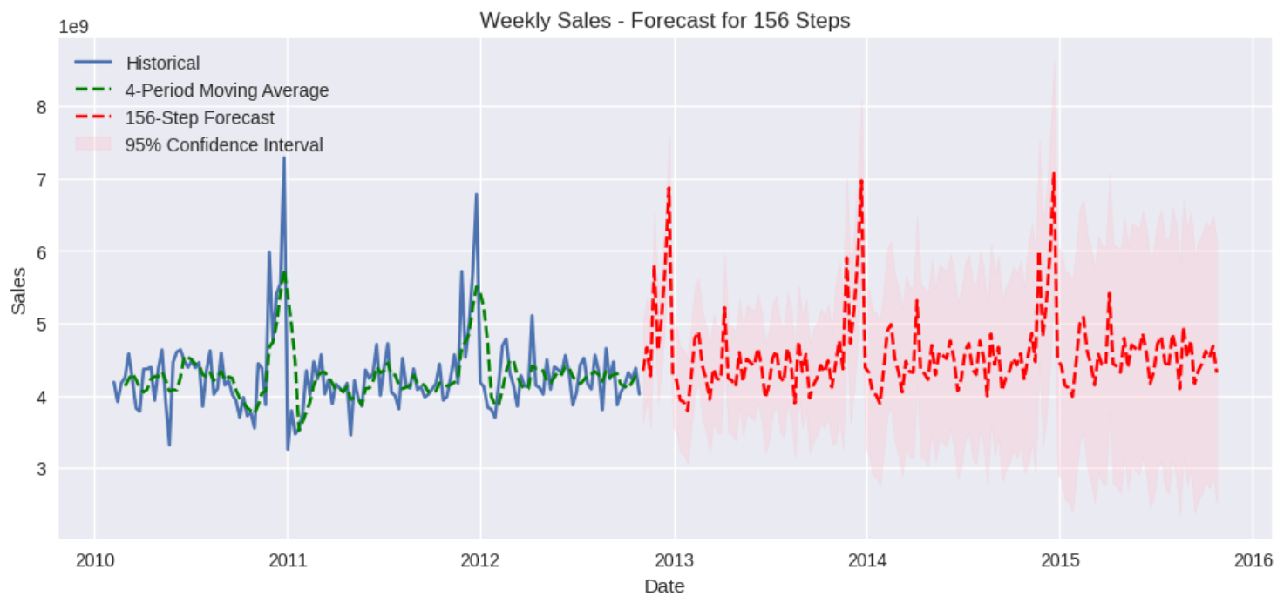
WEEKLY SALES FORECAST

Slide 17


07
INVENTORY OPTIMIZATION STRATEGY
Operational constraints: shelf space, lead time, stocking frequency, cost trade-offs
AI-driven reorder points, lead time planning, price elasticity
Store-level inventory personalization

Slide 18
BUSINESS IMPACT
Lower inventory holding costs
Increased on-shelf availability
Reduced markdowns & spoilage
Revenue & margin growth
Improved customer loyalty

Slide 19
FINAL STRATEGIC RECOMMENDATIONS
09
Hybrid forecasting architecture
Predictive replenishment automation
Empower store-level decisions via dashboards
Forecast performance reviews & continuous improvement

Slide 20



THANK YOU
thobekaj63@gmail.com
+227730885814
QUESTIONS ARE WELCOME AT THIS POINT
POWERING THE FUTURE WITH DATA-DRIVEN DECISIONS

